Slide 1
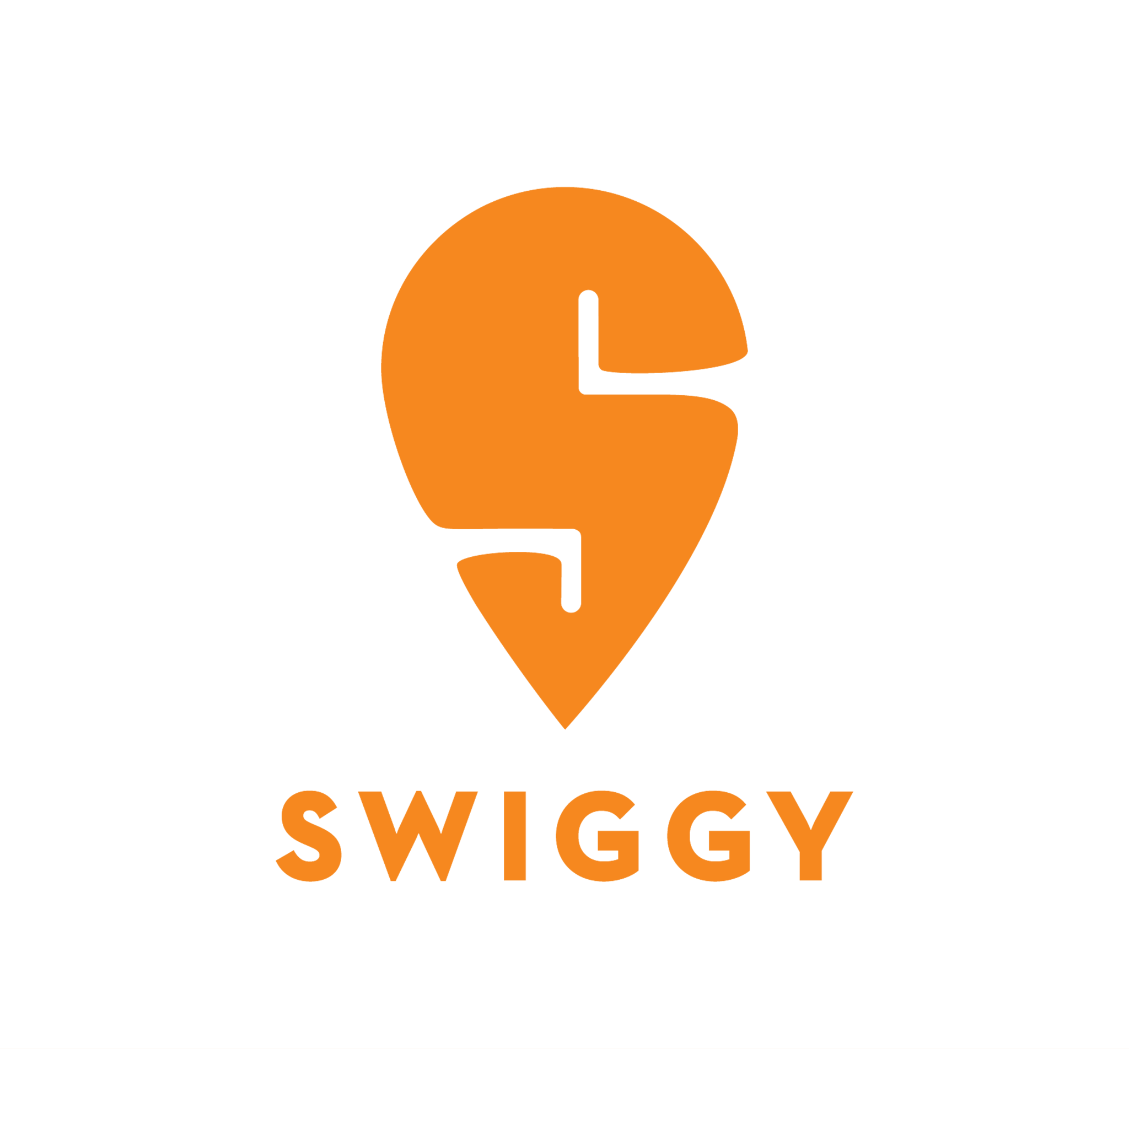

SWIGGY DATA ANALYSIS
SUBMITTED BY:
Manjunath Raikar

Slide 2
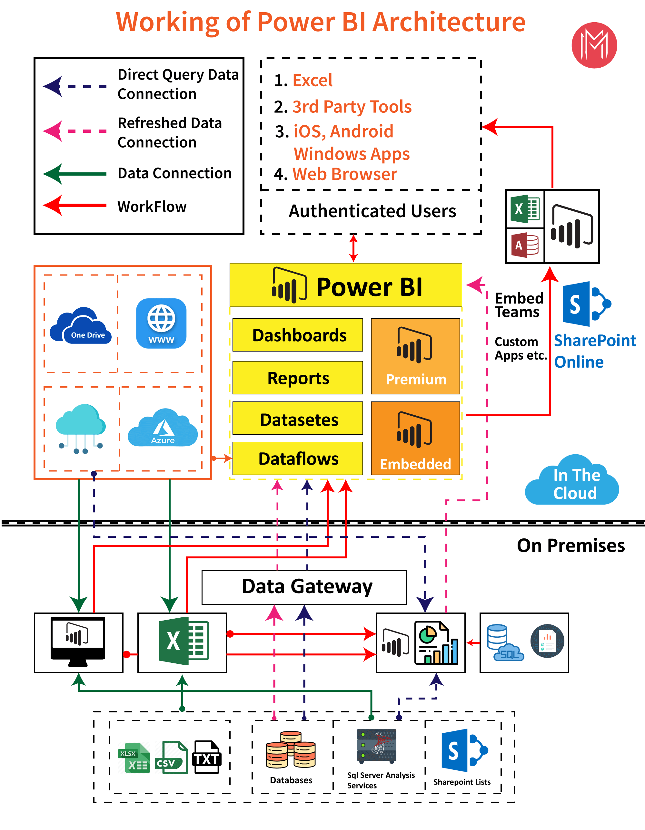
ARCHITECTURE

Slide 3
ETL OPERATIONS
Cleaning poorly formatted columns from the extracted raw data.
Skipping rows with Nan values.
Removing duplicated rows.
Changing the data types for necessary columns.

Slide 4
INSIGHTS

Slide 5
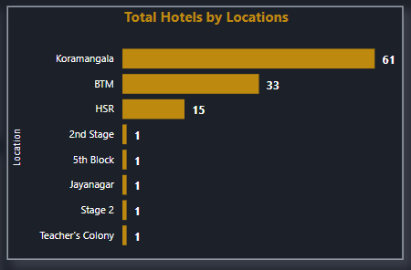
Locations with more number of shops are:
Koramangala - 63
BTM - 33
HSR - 15

Slide 6
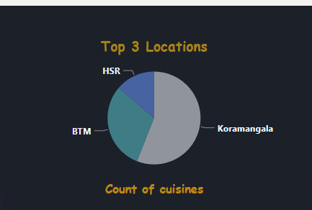
Koramangala location has more i.e, 53.39 % of availability of hotels

Slide 7
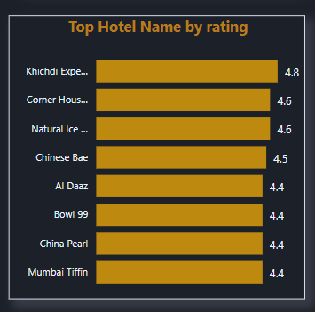
Khichdi Experiment has highest rating of 4.8 with a Price of 100/- per item.
Corner House Ice Cream and Natural Ice Cream are the shops with 4.6 rating, with the prices of 125/- and 75/-

Slide 8
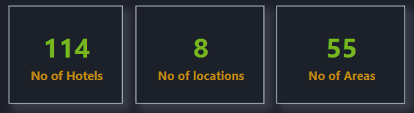
In Bangalore there are 114 Nos of Hotel,8 Nos of locations and 55 Nos of Areas

Slide 9
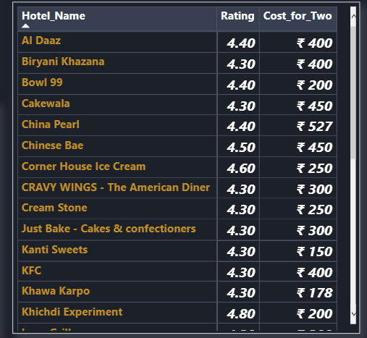
China hotel has highest price of 527/- among all the hotels in Bangalore
99 Variety Dosa & Tandoori Merchant hotels has least price of 50/- among all the hotels in Bangalore

Slide 10
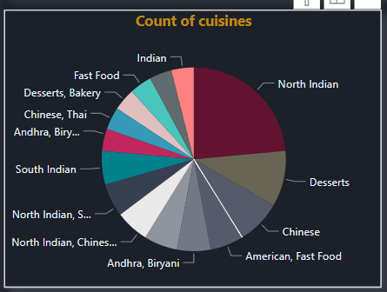
Only North Indian Cusine is mostly available in 12+ shops in Banglore and second top cuisine is Desserts and third is Chinses cuisine

Slide 11
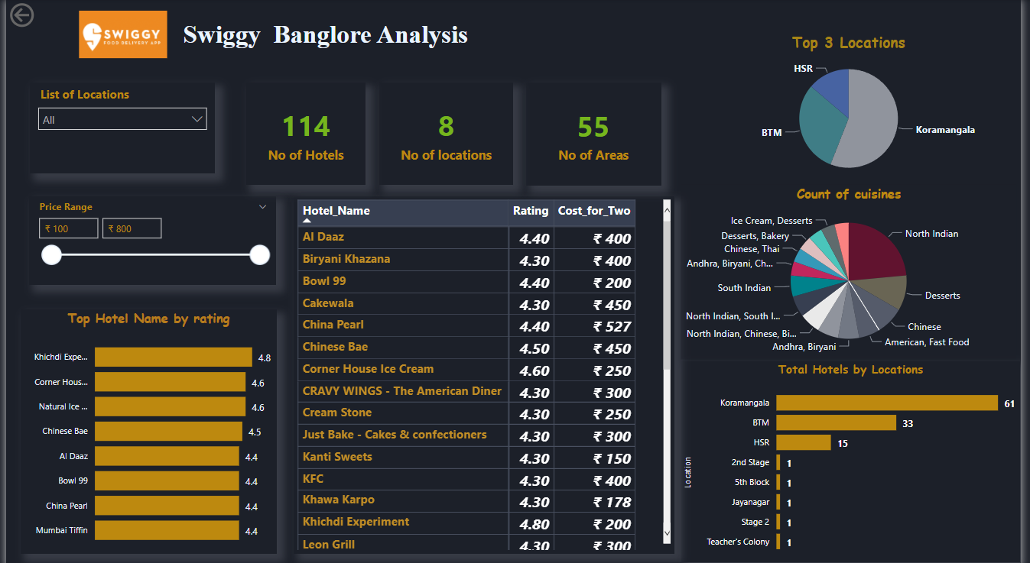
Final Dashboard

Slide 12
Conclusion:
Koramangala area has more number of shops with a total of 61 shops.
'BTM' location is 2nd with 33 shops, followed by 'HSR' with 15 shops.
Khichdi Experiment shop has highest rating of 4.8 and has a best price of 200 Rupees , it is located in Koramangala.
Based on ratings, top 10 shops are located in BTM,HSR & Koramangala.
Only North Indian Cuisine is mostly available in 12+ shops

Slide 13
In KORAMANGALA location,
'Khicidi Experiment' is the shop with best rating of 4.8 and price for two is 200 Rupees.
'Kanti Sweets' shop has less price of 150 Rupees, with a rating of 4.3
'Taco Bell' has a highest price of 00 rupees with a rating of 4.3
In BTM location,
'Chinese Bae' is the shop with highest price of 450 Rupees and its rating is 4.5.
'Tandoori Merchant' shop has less price of 100 Rupees, with a rating of 4.2
'99 VARIETY DOSA AND PAV BHAJI- Malli Mane Food' & 'Svadu Pure Ghee Sweet' has a price of 200 rupees
with a rating of 4.1
In HSR location,
'Mumbai Tiffin' & 'AI Daaz' have best rating of 4.4 and price is around 400 Rupees.
'New Udipi Grand' has least price of around 150 Rupees, with best rating of 4.3
'Dindigul Thalapakatti Biriyani' shop has high price, with a rating of 4.1

Slide 14
Q & A
What's the Source of the Data - Collected from Given Data Set
Which tools you are used in this entire project – Power Bi
How did you deploy the report - The report was deployed in my Power BI Public Server
What was the type of Data - Numerical and Categorical Values

Slide 15
THANK YOU

